Slide 1
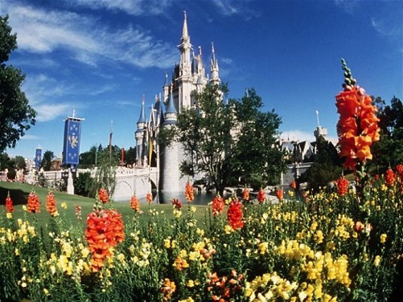
Creating & Sustaining a
Culture of Service Excellence
Lessons From the Mouse
Presented for the
California Grocers Association
by Dennis Snow

Slide 2
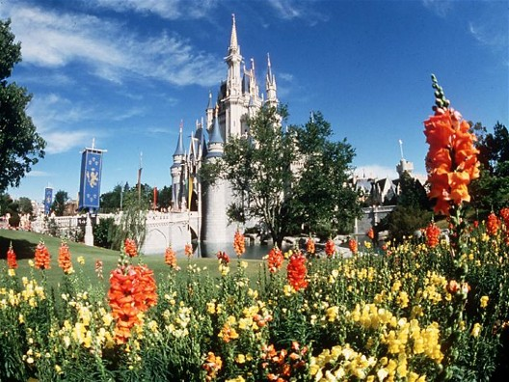
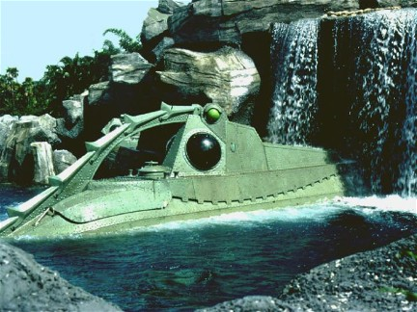

Slide 3
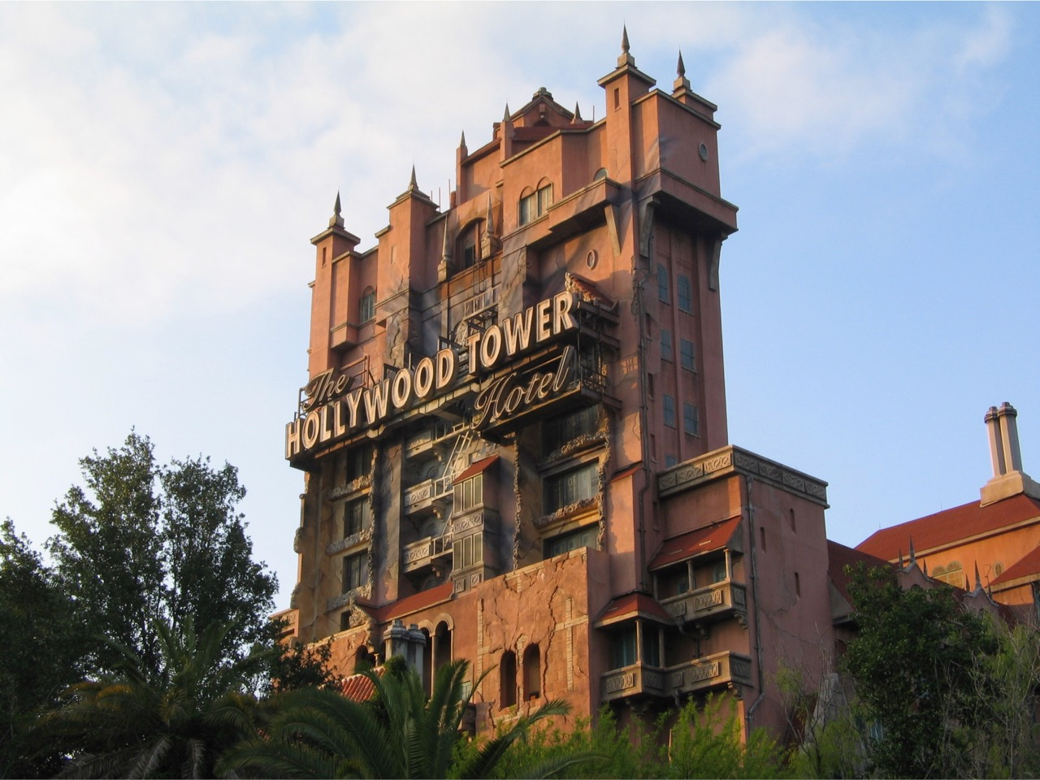

Slide 4
Why Customers Leave
____ Influenced by a friend 9%
____ Poor service 1%
____ Unhappy with the product 14%
____ Lured away by competition 3%
____ Moved away 68%
____ Died 5%

Slide 5
Why Customers Leave
____ Influenced by a friend
____ Poor service
____ Unhappy with the product
____ Lured away by competition
____ Moved away
____ Died
5%
68%
14%
9%
3%
1%

Slide 6
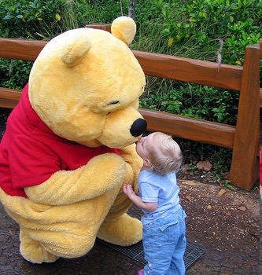
1
Look At Everything Through the Lens of the Customer

Slide 7
Service Mapping

Slide 8
Process – Product Question
(Requiring Research)
Place
call to
store
Navigate to proper department
Provide
customer
information
Explain
question or
issue
Research
answer

Slide 9
Process – Product Question
(Requiring Research)
Place
call to
store
Navigate to proper department
Provide
customer
information
Contacted
by
associate
Customer
waits for
answer
Explain
question or
issue
Listen to
explanation
Ask
follow-up
questions
Conclude
call

Slide 10

Service Mapping
Ride bus
to hotel
Enter
lobby
Ride
elevator
Ride
elevator
Enter
room
Walk to
room

Slide 11
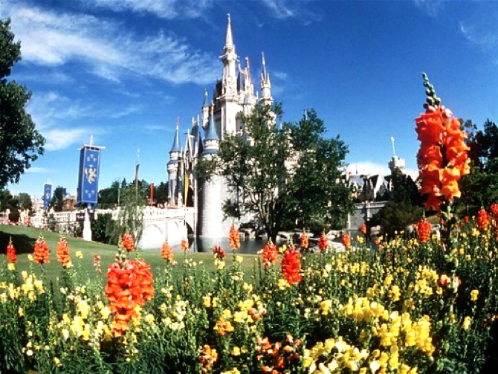
2
Pay Attention to the Details:
Everything Speaks

Slide 12
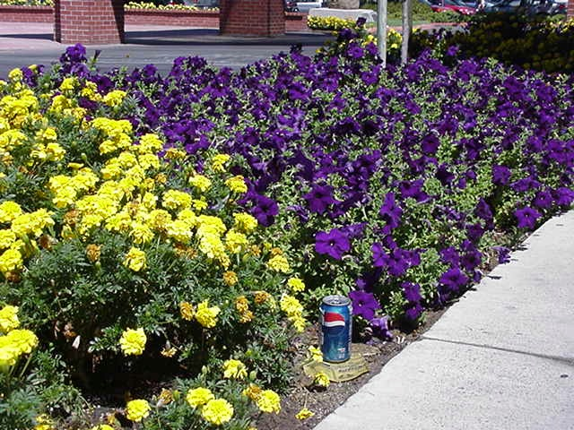

Slide 13
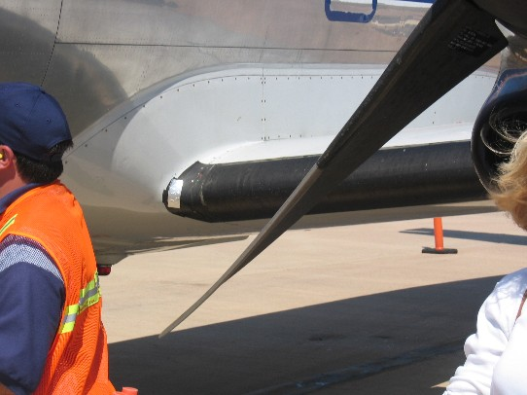
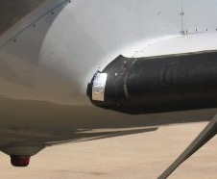

Slide 14
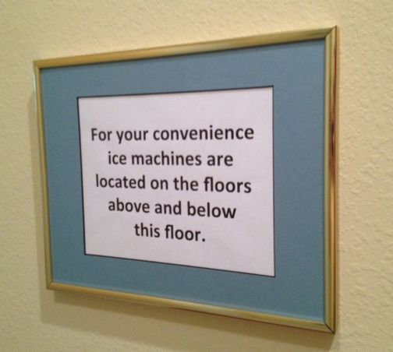

Slide 15
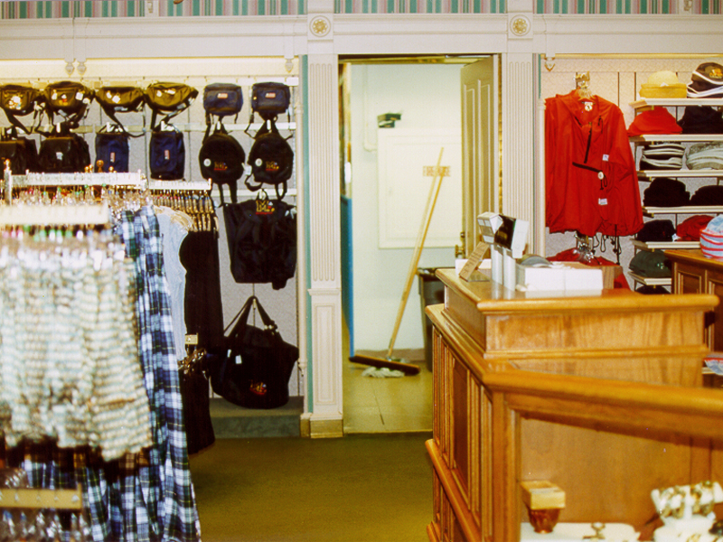

Slide 16
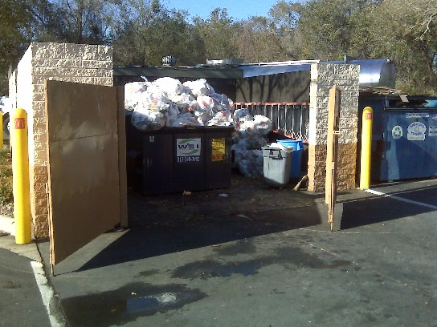

Slide 17
“Attitudinal” Backstage

Slide 18
For a strange definition of fun, consider that all that fun means is that four out of five people enjoy counting 'F's.

Slide 19
For a strange definition of fun, consider that all that fun means is that four out of five people enjoy counting 'F's.

Slide 20
Everything Speaks
Everything Speaks
Distracter
Everything Speaks
Commitment

Slide 21
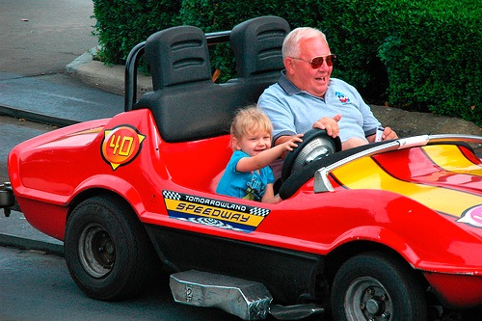
3
Create
Moments of Wow

Slide 22
Customer Expectations
Advice
Partnership
Availability
Accuracy
Wow
Opportunities
Dissatisfiers

Slide 23
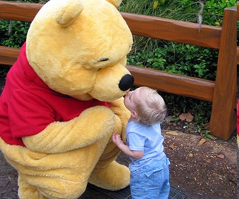
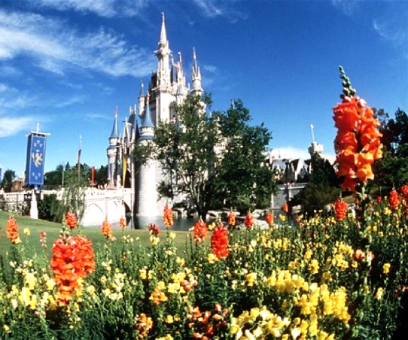
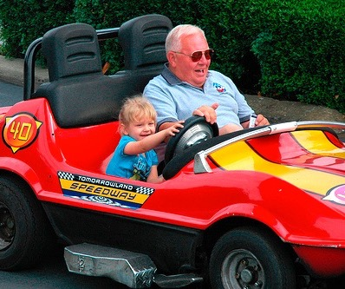
1
2
3
Lens of the Customer
Everything Speaks
Moments of Wow

Slide 24
Employee
Productivity
Customer
Value
Employee
Retention
Internal Service
Quality
Revenue/Profit
Growth
The Loyalty-Profit Chain
Harvard Business School
Customer
Loyalty
Shareholder
Value
External Service
Quality
Employee
Satisfaction
Customer
Satisfaction

Slide 25
Internal Service
Quality
Employee
Satisfaction
Employee
Retention
Employee
Productivity
External Service
Quality
The Loyalty-Profit Chain
Harvard Business School
Customer
Satisfaction
Customer
Value
Shareholder
Value
Revenue/Profit
Growth
Customer
Loyalty

Slide 26
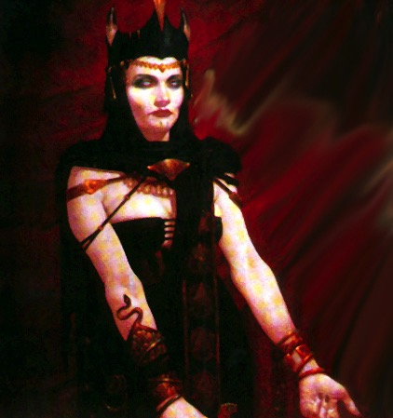
Notes:
This worked great. Got a good laugh. I think I can play off of this even more.

Slide 27
“Inculturate”
Service Excellence

Slide 28
Leading a Culture of
Service Excellence
Vision
Define the
customer experience
Culture
Involvement
Accountability

Slide 29
1
2
3
Lens of the Customer
Everything Speaks
Moments of Wow

Slide 30
Culture must be defined in
terms of behaviors

Slide 31
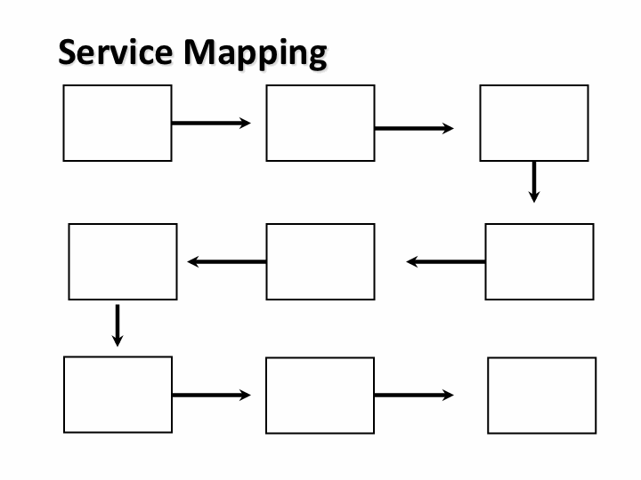
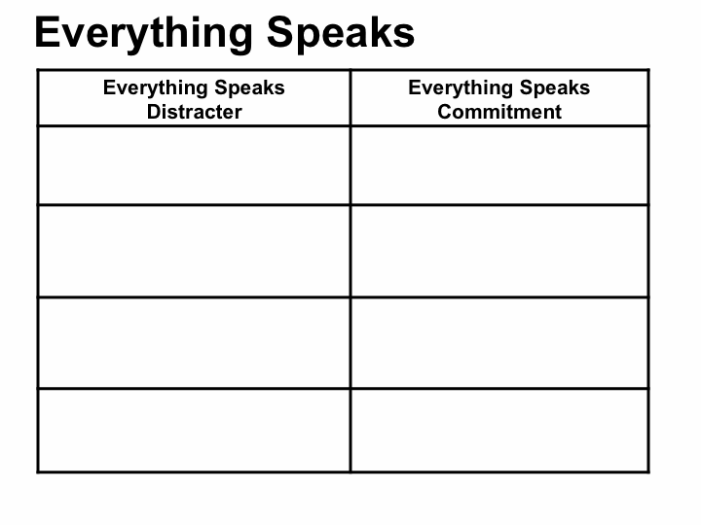
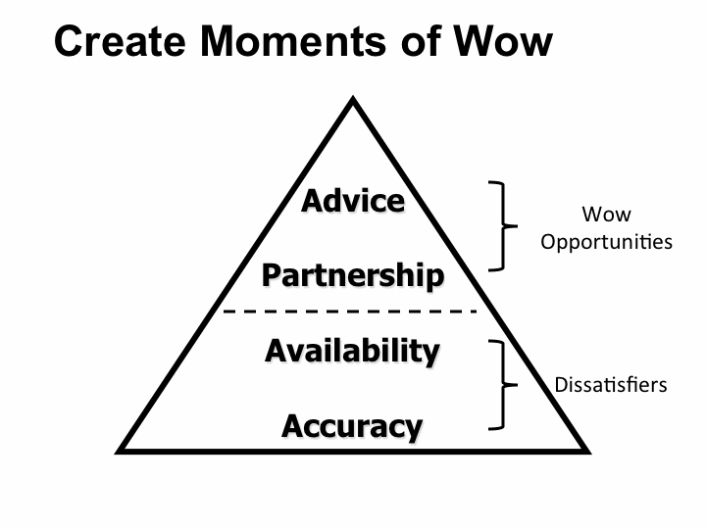
Service Improvement Tools

Slide 32
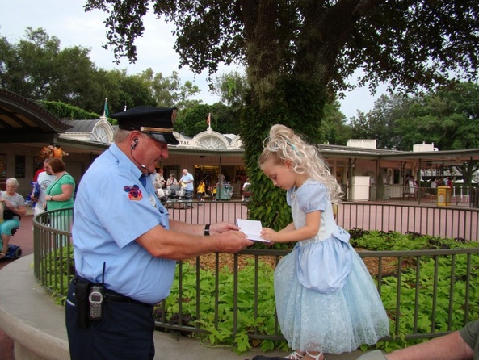

Slide 33
Leading a Culture of
Service Excellence
Vision
“Operationalize”
the service culture
Culture
Involvement
Accountability

Slide 34

©

Slide 35
Training and Communication
Engage
the
Heart

Slide 36
Effective training and communication ensures
the employee:
Is proud of the organization
Understands the “true product”
Knows what is expected

Slide 37
Leaders must be relentless
in reinforcing the vision

Slide 38
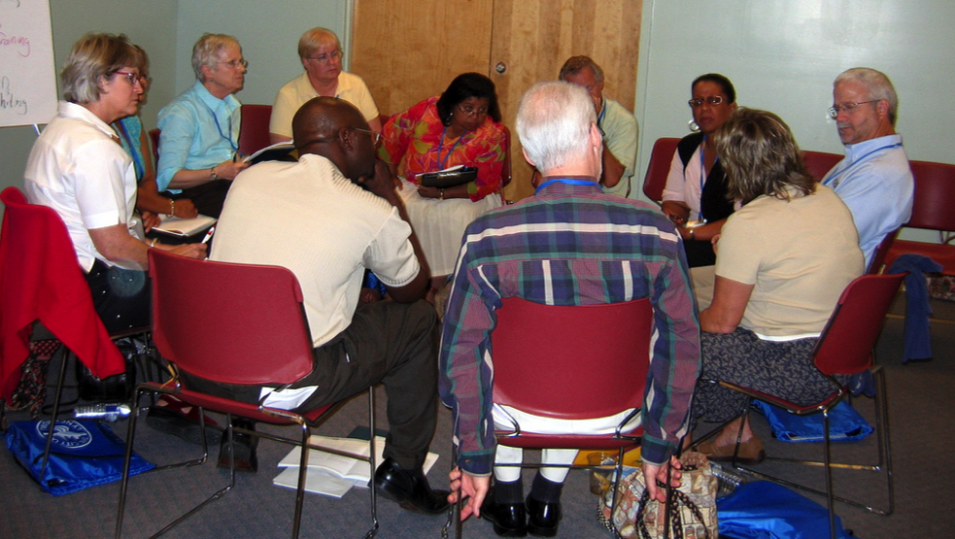
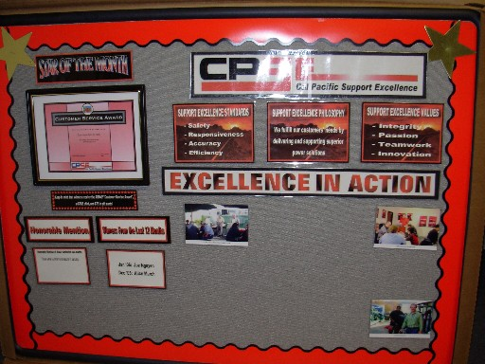


Communication

Slide 39
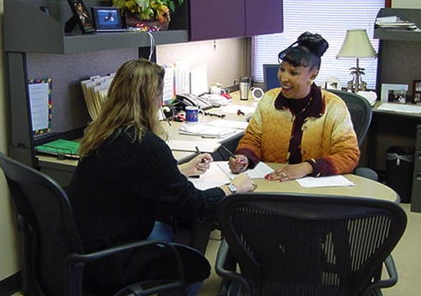
Interviewing and Selection

Slide 40
Interviewing and Selection
Skills
Knowledge
Talents

Slide 41
Select for
Talent
Study your best!!

Slide 42
Interviewing and Selection
Listen and watch for:
Sincerity of responses
Specifics and details
Appropriateness for your culture

Slide 43
The interviewing and selection process should model the culture of the organization

Slide 44
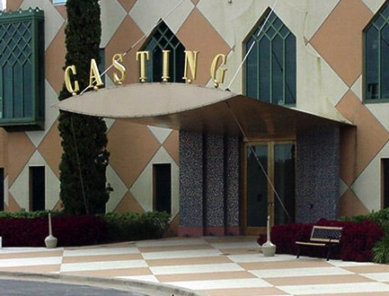
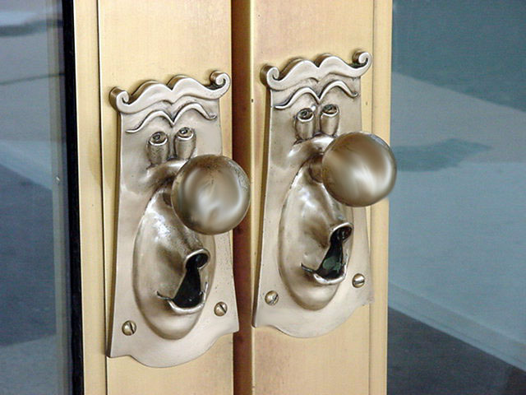

Slide 45
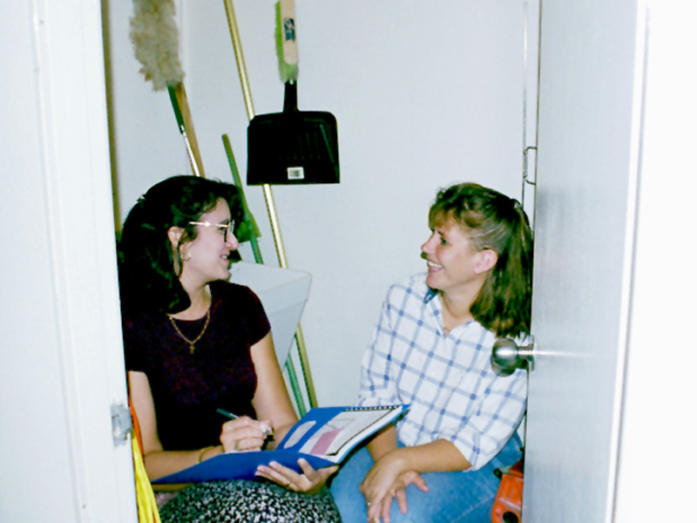
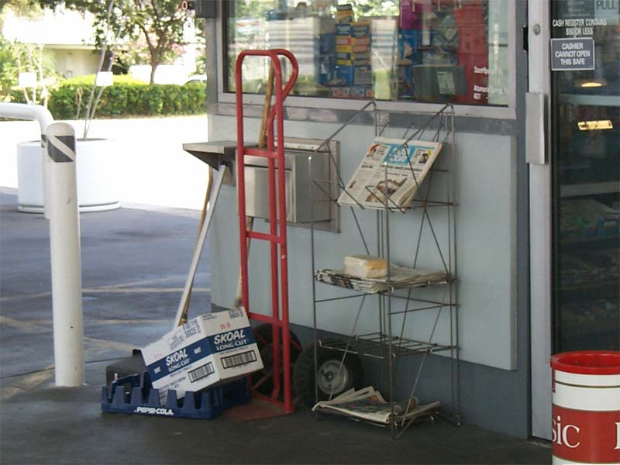
Notes:
27

Slide 46
Leading a Culture of
Service Excellence
Vision
Engage the minds
of employees
Culture
Involvement
Accountability

Slide 47
Barriers to Service Excellence

Slide 48
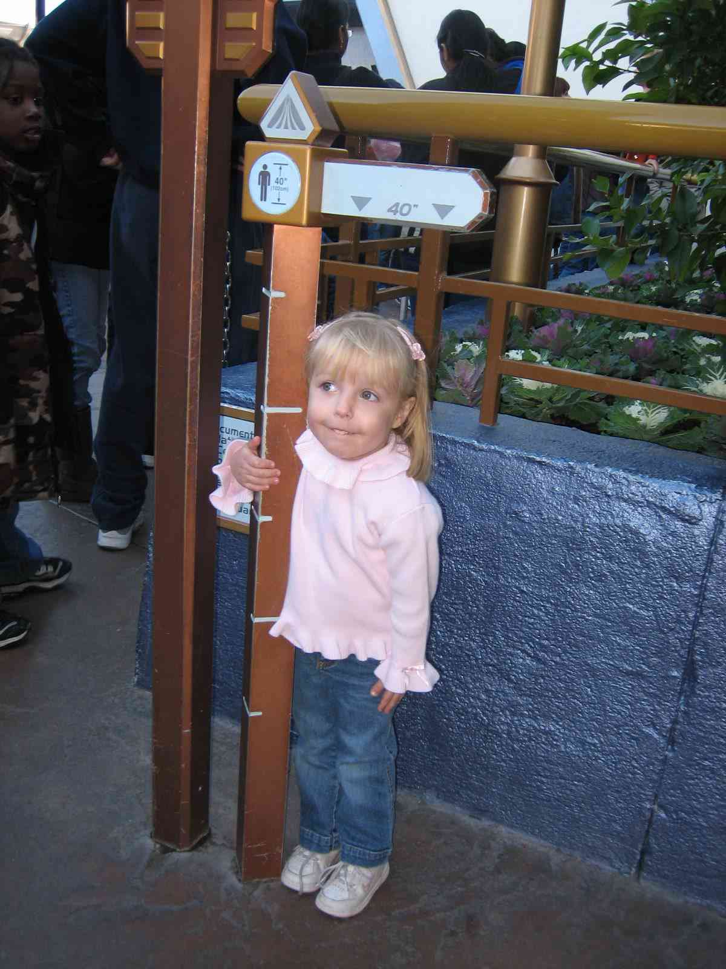


Slide 49
Leading a Culture of
Service Excellence
Vision
“Operationalize”
expectations
Culture
Involvement
Accountability

Slide 50
“Intolerable service
exists because intolerable service is tolerated.”

Slide 51
Coaching Employees
Position the discussion
Discuss the performance situation
Set a plan of action
Communicate the consequences of non-performance
Set a follow-up plan

Slide 52
Never let the coaching
moment go.

Slide 53
Never let the recognition
moment go.

Slide 54
Recognition
– Builds pride
Organization-to-employee
Peer-to-peer
Manager-to-employee
– Builds sense of family
– Builds trust

Slide 55
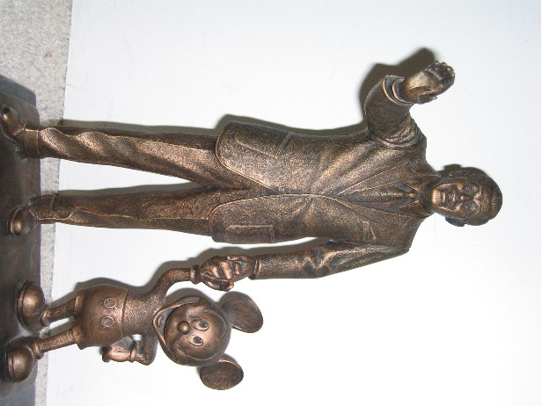
Recognition
To “Know Again”

Slide 56
Leading a Culture of
Service Excellence
Vision
“Operationalize”
the service culture
Define the
customer experience
“Operationalize”
expectations
Engage the minds
of employees
Culture
Involvement
Accountability

Slide 57
Walking the Talk
“The problem isn’t that
your people don’t know what
you’re doing. The problem
is that they do know
what you’re doing.”
Tom Peters

Slide 58
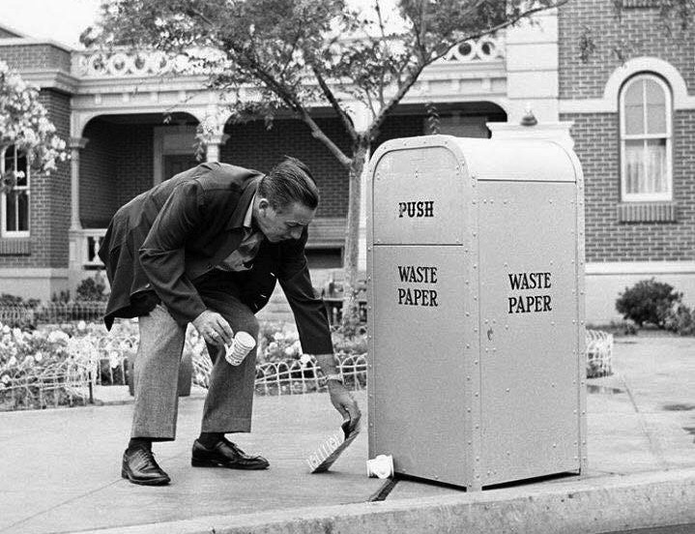

Slide 59
“Five specific behaviors that would
demonstrate my commitment to
excellent service include…”

Slide 60

Customer Loyalty

Slide 61



Slide 62
Creating & Sustaining a
Culture of Service Excellence
Lessons From the Mouse
Presented for the
California Grocers Association
by Dennis Snow

