Slide 1
CBD Manufacturing & Sales Compliance Webinar
Hosted by CGA Educational Foundation
Presented by Patrick Goggin, Esq.
November 17, 2021

Slide 2
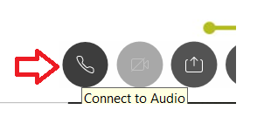
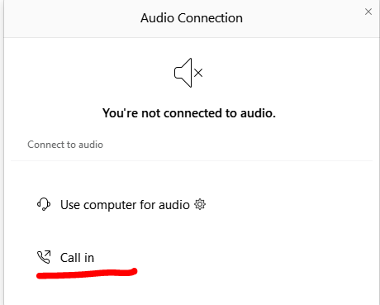
Can’t Hear the Program?
Click the telephone icon at the bottom of the screen.
Select Call In and information will appear to join the webinar via telephone.

Slide 3
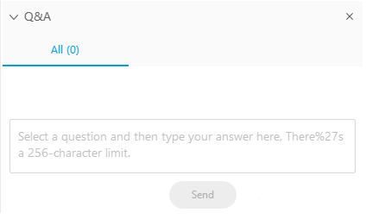
Questions During Program
Please use the Q&A Box on the right side of your screen to send questions during the presentation.

Slide 4
Webinar Disclosure
By hosting this Webinar, California Grocers Association (CGA) and the CGA Educational Foundation (CGAEF) are providing an opportunity for their members and attendees to obtain general information that may be of interest to your company. The Webinar is designed to provide practical and useful information on the subject matter covered. However, CGA /CGAEF is not engaged in rendering legal, accounting or other professional advice or services.
CGA/CGAEF does not review or approve the content of the webinar presented by guest speakers and others, and makes no representations or warranties about the accuracy or legality of any compliance or other recommendations provided during the webinar. If legal advice or other expert assistance is required, the services of a competent professional should be sought.

Slide 5
Speaker Introduction
Patrick D. Goggin, Esq.
Law Offices of Patrick Goggin

Slide 6
PATRICK D. GOGGIN, ESQ.
J.D. from Lewis & Clark Law School, Environmental Cert. (1996)
Co-counsel: HIA v. DEA (2004) – Hemp foods (seed) lawful
Vote Hemp Director – National advocacy (2005 – present)
California Hemp Farming Act (2005 – 2013) – 3 Vetoes!
California Hemp Council (2018) – Chief Counsel
AB 45 (2018 – 2021)

Slide 7
WHAT DID AB 45 DO?
Immediately authorized Industrial Hemp Products manufactured with hemp flower in CA (Oct. 8, 2021)
Hemp seed products already GRAS (FDA 2018)
Removed CDPH July 2018 FAQ that CBD rich hemp products prohibited and adulterant (FDA)
CDPH to regulate hemp product manufacturing
Authorized inhalable hemp products when tax adopted

Slide 8
OVERVIEW
Urgency Clause: Industrial Hemp Products now OK – not adulterated
Final form extract <0.3% THC
CDPH: Emergency Rulemaking/Regulations
Hemp product manufacturers:
register with CDPH by January 2022 (GMP)
Labeling/packaging compliance by January 6, 2022

Slide 9
EMERGENCY RULEMAKING
Registration for Hemp Product Manufacturers – including out-of-state (Sherman Act)
Necessary clarifications/guidance?
0.3% THC limit in final form extract vs. final form product Labeling?
Cannabinoids produced via chemical synthesis prohibited
Chemical synthesis not defined

Slide 10
CDPH AUTHORIZED TO REGULATE
Minimum age
CBD/cannabinoid serving size and servings per container caps
In-process “hot” hemp THC limits (not final form)
Recordkeeping standards for supply chains including Retailers

Slide 11
COMPLIANT PRODUCTS
Manufacturer registered with CDPH
Proper labeling/packaging
Link to Certificate of Analysis (COA)
Total THC (not just Delta-9)
Contaminant levels (same as cannabis)
Child/pregnancy warnings
FDA statement

Slide 12
RED FLAGS TO LOOK OUT FOR
Manufacturer not registered w/CDPH
Product only measures Delta-9 THC vs. Total THC
Improper labeling
Product not produced from compliant hemp
Untrue health related statements

Slide 13
RETAILER COMPLIANCE RESPONSIBILITIES/CHECKLIST
Documents
COAs – farming/final form extract (< 0.3% THC)
final form product – THC and CBD amounts
Farming and manufacturing registration
Labeling
Link to COA and statements
Nutrition/Supplement Facts Panel

Slide 14
Questions?
Patrick D. Goggin, Esq.
pdgogginlaw@gmail.com
(415) 312-0084

