Slide 1
Webinar: New Laws for 2024
Hosted by: CGA Educational Foundation
December 6, 2023

Slide 2
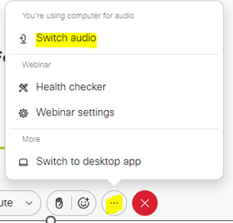
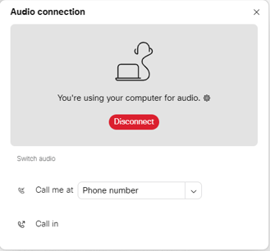
CAN’T HEAR THE PROGRAM?
Click the three dots at the bottom of the screen, and select Switch Audio.
Select your preferred method of connection for the webinar.

Slide 3
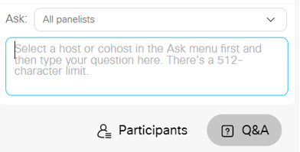
QUESTIONS DURING PROGRAM
Use the Q&A Box on the right side of your screen to send questions during the presentation.
Send questions to All Panelists

Slide 4
WEBINAR DISCLOSURE
By hosting this Webinar, California Grocers Association (CGA) and the CGA Educational Foundation (CGAEF) are providing an opportunity for their members and attendees to obtain general information that may be of interest to your company. The Webinar is designed to provide practical and useful information on the subject matter covered. However, CGA /CGAEF is not engaged in rendering legal, accounting or other professional advice or services.
CGA/CGAEF does not review or approve the content of the webinar presented by guest speakers and others, and makes no representations or warranties about the accuracy or legality of any compliance or other recommendations provided during the webinar. If legal advice or other expert assistance is required, the services of a competent professional should be sought.

Slide 5
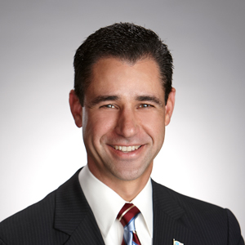
ABOUT OUR PRESENTERS
Louie Brown
Kahn, Soares & Conway, LLP
(916) 448-3826
lbrown@kscsacramento.com
www.ksclawyers.com
Michel LeClerc
North State Grocery
(530) 377-7137
mleclerc@nsgrocery.com

Slide 6
Kahn, Soares & Conway, LLP provides the information for the California Grocers Association Educational Foundation New Laws Webinar for informational purposes only. This general information is not a substitute for legal advice, and users should consult with legal counsel for specific advice. In addition, using this information does not create an attorney-client relationship with Kahn, Soares & Conway, LLP.

Slide 7
NEW LAWS FOR 2024
AB 594 – Labor Alternative Enforcement
AB 647 – Grocery Worker Retention Act
SB 553 – Workplace Violence
SB 616 – Paid Sick Leave
SB 848 – Reproductive Loss Leave
Cannabis use
Bottle Bill Changes

Slide 8
AB 594 – Labor Alternative Enforcement
Until 1/1/2029, a public prosecutor is authorized to prosecute an action, civil or criminal, for a violation of the Labor Code.
Wage and hour violations
Employment relations

Slide 9
AB 594 – Labor Alternative Enforcement
Moneys recovered by prosecutors shall be applied first to payments, such as wages, damages, and other penalties, due to affected workers.
Injunctive relief is available
Attorneys fees may be awarded to prevailing plaintiff

Slide 10
AB 647 – Grocery Worker Retention – amendments
Adds distribution centers owned and operated by a grocery establishment to the law.
Adds the requirement for the incumbent grocer to provide cell phone and email addresses of employees, if known, to the successor grocer and a collective bargaining representative.
Prohibits an employer from taking adverse action against an employee seeking to enforce rights under the Grocery Worker Retention law.
Provides the opportunity for an aggrieved employee or a representative of the employee to bring an action in superior court against the employer for violations of the Act.

Slide 11
AB 647 – Grocery Worker Retention – amendments
An aggrieved employee may be awarded:
Hiring and reinstatement
Front pay or back pay for each day a violation occurred
Benefits
Punitive damages
Attorney fees
Employer is provided 33 days notice and given the opportunity to cure the alleged violation
Labor Commissioner may also take enforcement action

Slide 12
AB 647 – Grocery Worker Retention – amendments
Grocery worker retention act does not apply to an incumbent and successor employer, if the sum of the following is less than 300:
Number of workers employed by the incumbent employer, immediately prior to the change of control; and
Number of workers employed by the successor employer, immediately prior to the change of control.

Slide 13
SB 553 – Workplace Violence
On July 1, 2024, an employer is required to establish, implement and maintain an effective workplace violence prevention plan (WVPP).
An employer is required to record information in a violent incident log for every workplace violence incident and maintain records of workplace violence hazard identification, evaluation, correction and training.
Employers are required to train employees on the WVPP and provide additional training when a new or previously unrecognized workplace violence hazard is identified.

Slide 14
SB 553 – Workplace Violence
“Credible threat of violence” is a knowing and willful statement or course of conduct that would place a reasonable person in fear for their safety, or the safety of their immediate family, and that serves no legitimate purpose.
On 1/1/25, a collective bargaining representative of an employee may seek a temporary restraining order after hearing of workplace violence in the workplace.

Slide 15
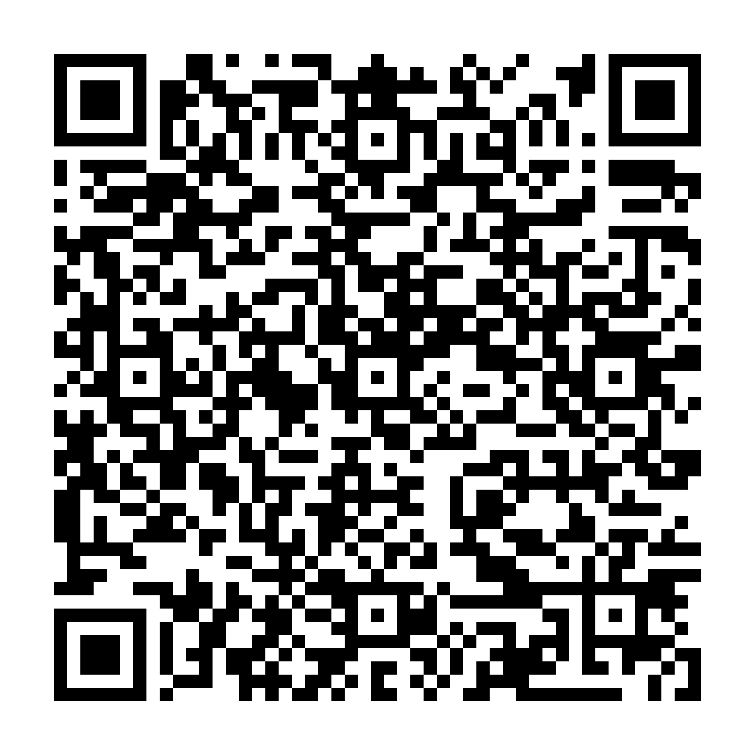
SB 553 – Workplace Violence
CGA Member Discount
Chamber’s webinar California’s New Workplace Violence Standards
15% Off Discount valid through 2/29/2024

Slide 16
SB 616 – Paid Sick Leave
5 days or 40 hours

Slide 17
SB 848 - Leave for Reproductive Loss
It is an unlawful employment practice to refuse to grant a request by an eligible employee to take up to 5 days of reproductive loss following a reproductive loss event.
Leave may be taken within 3 months of the event.
If the employee experiences more than one event with a 12-month period, the employer is not obligated to grant a total amount of loss leave in excess of 20 days.
Days taken may be nonconsecutive.
Leave may be unpaid. Employee can choose to use vacation, personal leave, sick leave, or other time off.

Slide 18
SB 848 - Leave for Reproductive Loss
Employee means a person employed for at least 30 days prior to the commencement of the event.
Reproductive loss event means the day or, for a multi-day event, the final day of a failed adoption, failed surrogacy, miscarriage, stillbirth or an unsuccessful assisted reproduction.

Slide 19
Cannabis Use
On and after 1/1/2024, it is unlawful for an employer to discriminate against a person in hiring, termination, or any term or condition of employment, if the discrimination is based upon the person’s use of cannabis off the job and away from the workplace.
Does not prohibit an employer from discriminating in hiring based on scientifically valid preemployment drug screening conducted through methods that do not screen for nonpsychoactive cannabis metabolites.
This bill does not permit an employee to possess, use, or be impaired by cannabis on the job.

Slide 20
Cannabis Use
It is unlawful for an employer to request information from an applicant relating to the applicant’s prior use of cannabis.
Information obtained about a person’s prior use of cannabis from the person’s criminal history is exempt.

Slide 21
Bottle Bill Changes
Effective 1/1/2024, new containers in the program include:
Wine and distilled spirits, including boxes, pouches, bladders and similar containers are included in the bottle bill.
100 percent fruit juice 46 oz or more
100 percent vegetable juice above 16 oz
Requirement for shelf tags delayed until 1/15/2024.
Dealer webinar hosted by CalRecycle on December 14.

Slide 22
Bottle Bill Changes
Wine or distilled spirits packaged in a box, bladder, pouch or similar container - $0.25 CRV deposit.
All other wine or distilled spirit containers – CRV deposit $0.05 under 24 oz and $0.10 24 oz and above.
A CRV labeling message is option, but not required between 1/1/2024 through 6/30/2025.
Wine and distilled spirits bottled prior to 1/1/2024 are not required to have a CRV label – ever.

Slide 23
Bottle Bill Changes
Large fruit and vegetable juice containers filled after July 1, 2024 are required to have a CRV label.
Large fruit and vegetable juice containers filled prior to July 1/2024 are not required to be CRV labeled – ever.

Slide 24
Minimum Wage
$16.00/hour

Slide 25
QUESTIONS?

Slide 26
Louie Brown
Kahn, Soares & Conway, LLP
916-448-3826
lbrown@kscsacramento.com
www.ksclawyers.com

