Slide 1
2025 New Laws Impacting CGA
November 12, 2024

Slide 2
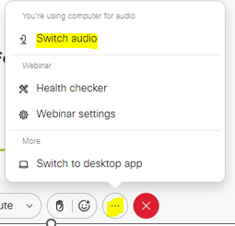
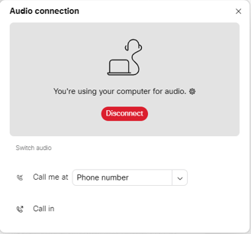
CAN’T HEAR THE PROGRAM?
Click the three dots at the bottom of the screen, and select Switch Audio.
Select your preferred method of connection for the webinar.

Slide 3
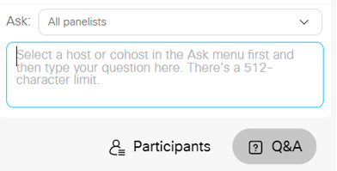
QUESTIONS DURING PROGRAM
Use the Q&A Box on the right side of your screen to send questions during the presentation.
Send questions to All Panelists

Slide 4
WEBINAR DISCLOSURE
By hosting this Webinar, California Grocers Association (CGA) and the CGA Educational Foundation (CGAEF) are providing an opportunity for their members and attendees to obtain general information that may be of interest to your company. The Webinar is designed to provide practical and useful information on the subject matter covered. However, CGA /CGAEF is not engaged in rendering legal, accounting or other professional advice or services.
CGA/CGAEF does not review or approve the content of the webinar presented by guest speakers and others, and makes no representations or warranties about the accuracy or legality of any compliance or other recommendations provided during the webinar. If legal advice or other expert assistance is required, the services of a competent professional should be sought.

Slide 5
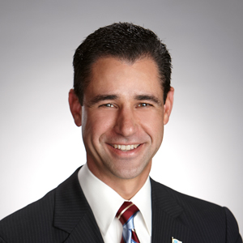
ABOUT OUR PRESENTERS
Louie Brown
Kahn, Soares & Conway, LLP
(916) 448-3826
lbrown@kscsacramento.com
www.ksclawyers.com
Michel LeClerc
North State Grocery
(530) 377-7137
mleclerc@nsgrocery.com

Slide 6
AB 98: Logistic Use, Routes & Bldg. Design
Requires the siting of a new or expansion (20%) of a logistic use within 900 ft of a sensitive receptor, must incorporate a range of setbacks (300-500 ft), building design standards (lighting, EV charging, bay orientation, truck routing, HVAC, mitigation standards, forklifts, parking, landscaping, parking, buffers, etc.).
Logistics use-a building where cargo, goods, or products are moved or stored for later distribution to business or retail customers, or both, that does not predominantly serve retail customers for onsite purchases, and heavy-duty trucks are primarily involved in the movement of the cargo, goods, or products.
Does not include: “Facilities where food or household goods are sold directly to consumers and are accessible to the public.”
Sensitive receptor- home, school, day care center, park, nursing home, hospital
Additional bill components: Requires local Circulation Element updates, truck routes, changes to South Coast AQMD Indirect Source Rule
Effective date: January 1, 2026

Slide 7
AB 98 Design Standards
“21 Century Warehouse Design”
Bldg. energy efficiency standards: (A) Solar installation and battery storage; (B) Cool roofing; (C) MD and HD vehicle charging readiness; (D) LD EV charging readiness and charging stations.
Has skylights in at least 1% roof area, or equivalent LED efficient lighting.
Conduits and electrical hookups at all loading bays serving cold storage. Idling or use of auxiliary truck engine power for climate control equipment prohibited if the truck is capable of plugging in at the loading bay.
Any heating, ventilation, and air-conditioning is high-efficiency.
All forklifts and small-off road engines used on site are ZE by 2030 to the extent operationally feasible (excluding cost)
Tier 1 (21st Century +):
For photovoltaic system installation and battery storage all warehouse square footage considered conditioned space.
Has a microgrid-ready switchgear system capable of supporting distributed energy resources.
Is advanced smart metering ready.
Minimum 50% passenger vehicle parking spaces preinstalled with conduit to support EV charging.
Minimum 10% passenger vehicle parking spaces installed with EV charging stations.
All classes of forklifts used on site are ZE by January 1, 2028

Slide 8
SB 1046: Pre-Checkout Bags
Prohibits a store from providing a pre-checkout bag if that bag isn’t compostable or recycled paper
“Pre-checkout bag” means a bag provided to a customer before the customer reaches the point of sale, that is designed to protect a purchased item from damaging or contaminating other purchased items in a checkout bag, or to contain an unwrapped food item.
Effective date: January 1, 2025

Slide 9
SB 1053: Carryout Bag Prohibition
Prohibits a store from providing, distributing, or selling a carryout bag at point of sale except when:
A store provides a recycled paper bag at the point of sale; and
A store sells recycled paper bags for not less than 10 cents
Allows stores to distribute recycled paper bags at no cost for low-income consumers
Prohibits a store from requiring a customer to use, purchase, or accept a recycled paper bag or a compostable bag as a condition of sale of any product.
Defines “recycled paper bag" as containing 50% minimum postconsumer recycled materials after January 1, 2028.
Effective date: January 1, 2026

Slide 10
SB 1013: Dealer Cooperative
Eliminates the option for grocers to pay $100/day in lieu payment for not redeeming in store
Requires grocers to either:
(1) Join a dealer cooperative to provide a dealer cooperative and follow a redemption plan to serve that convenience zone or
(2) Implement an in-store take back program
Effective date: January 1, 2025

Slide 11
SB 1089: Store Closure
A covered establishment shall, no later than 45 days before closure, perform the following:
Provide written notice to employees and their authorized representative
Notice to employees is to provided no later than 30 days for covered establishments with less that 5 employees
The Employment Development Department
The State Department of Social Services
The local workforce development board (city and county)
The chief elected official of the city and county
A covered establishment owned by a person who owns 15 or fewer stores nationwide does not need to provide notice the EDD, local workforce board or local elected officials.
The covered establishment must post a written notice of the closure in a conspicuous location at the entrance
Take reasonable steps to provide written notice in a form the covered establishment regularly communicates or advertises to customers.
Notice not required if closure is caused by physical calamity, war, or business circumstances not reasonably foreseeable at the time the notice is required.
Civil penalty not to exceed $10,000 brought by any person injured by the violation.

Slide 12
SB 399: Employer Communications
Prohibits an employer from threatening an employing with discharge, discrimination, retaliation or adverse action because an employee declines to attend an employee-sponsored meeting or listen to communication re: employer’s opinion about religious or political matter.
“Political matters” matters relating to elections for political office, political parties, legislation, regulation, and the decision to join or support any political party or political or labor organization.
$500 civil penalty per employee per violation
Effective date: January 1, 2025

Slide 13
SB 428: Temporary Restraining Order (TRO)
Authorizes an employer whose employee has experienced harassment to seek a TRO and an injunction on behalf of their employee with clear and convincing evidence of irreparable harm
Requires an employer to allow employee to not be named in TRO before filing
Effective date: January 1, 2025

Slide 14
SB 1100: Driver’s License
Prohibit employers from including statement on job posting material that applicant must have driver’s license
Exceptions: Driving is one of the job functions and alternative form of transportation (ride-hailing, biking, walking) would not be comparable in time travel or cost
Effective date: January 1, 2025

Slide 15
AB 2123: Paid Family Leave
Employers may not require employees to take up to two weeks of accrued vacation before being able to access Paid Family Leave (PFL)
Effective date: January 1, 2025

Slide 16
AB 375: Food Platform Delivery Driver Disclosure
Existing law: Fair Food Delivery Act of 2020 regulates third-party food delivery platforms
Requires platforms to disclose delivery driver’s first name and picture to customer and notify customer when purchase is out for delivery
Exceptions:
If food facility uses their own delivery drivers for delivery of order
If food facility receives order through its internet website or a third-party that it’s a food delivery platform
Effective date: March 1, 2025

Slide 17
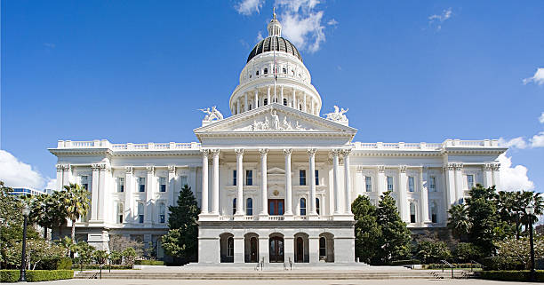
Questions?

Slide 18
Louie Brown
Kahn, Soares & Conway, LLP
916-448-3826
lbrown@kscsacramento.com
www.ksclawyers.com

